Slide 1
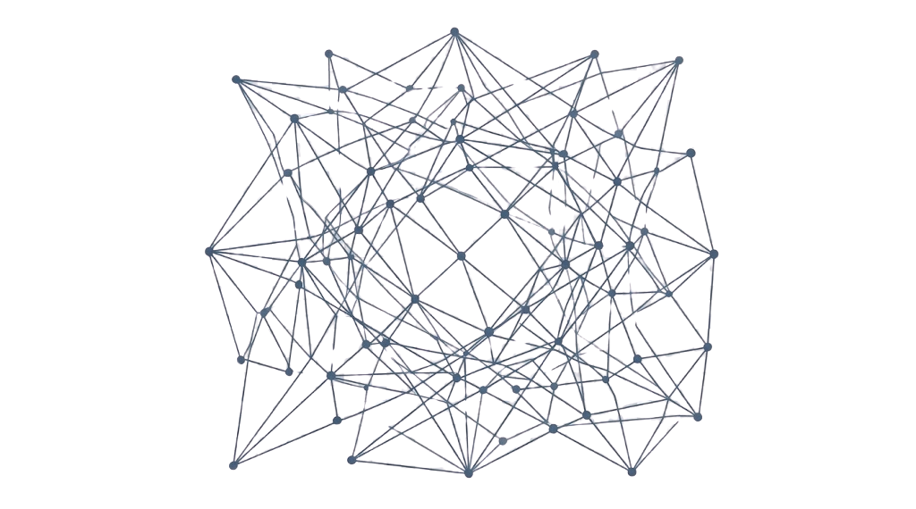
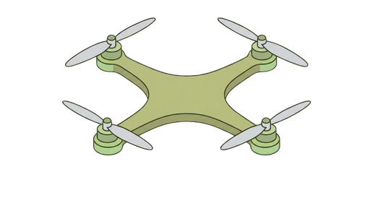
3D MAPPING OF AN ENVIRONMENT USING NORMAL MONOCULAR CAMERA AND CONTROLLING THE DRONE BY VISUAL-INERTIAL ODOMETRY (VIO)
Preseneted by Group CD2
Ravishanmugam K — CB.SC.U4AIE24347
Ishwarya M — CB.SC.U4AIE24220
Aparna B — CB.SC.U4AIE24304
Cibikumar B — CB.SC.U4AIE24212
Akhilan S — CB.SC.U4AIE24362

Slide 2
ABSTRACT:
A First-Principles, Euler-Angle-Free Approach for
Autonomous Multirotor UAVs
Proposed System
Integration and Simulation
Key Advantages
A first-principles geometric flight
controller using (SO(3)) and unit-
quaternion representations for
autonomous multirotor UAV
attitude control. Combines position
tracking, force generation, and
non-linear dynamics for commands.
Integrated with ArduPilot SITL,
Gazebo, ROS 2/DDS, and MATLAB.
This forms a distributed
simulation environment for
evaluating autonomous flight
control.
By avoiding Euler-angle
representations, the proposed
approach provides a mathematically
consistent framework for three-
dimensional attitude control
without gimbal-lock singularities.

Slide 3
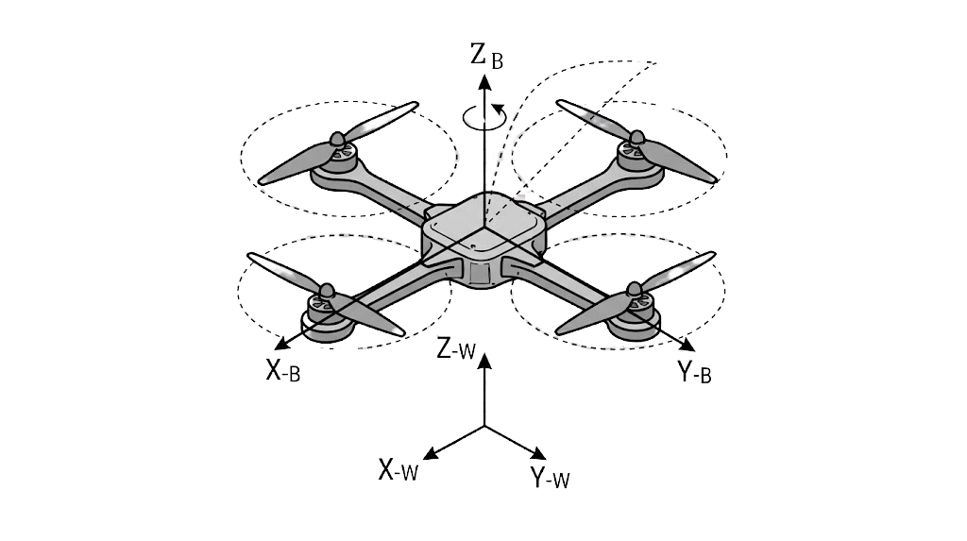
INTRODUCTION:
Nonlinear, underactuated multirotor UAVs require advanced
geometric control using SO(3) and quaternions to overcome Euler
angle singularities and gimbal lock during autonomous flight.
Geometric Controller (SO(3))
Unit Quaternions (q)
Integration Environment
Integrated with ArduPilot
SITL, Gazebo, ROS 2/DDS,
and MATLAB for a realistic
simulation and
experimentation testbed. Using MAVLINK for low level messages
Develops a first-principles
geometric control framework
for accurate position and
attitude tracking, avoiding
Euler angles and singularities
Utilizes unit quaternion state
representations for non-
singular attitude control,
enabling complex and
aggressive maneuvers

Slide 4



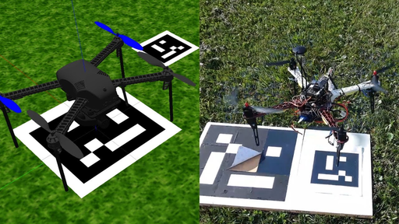

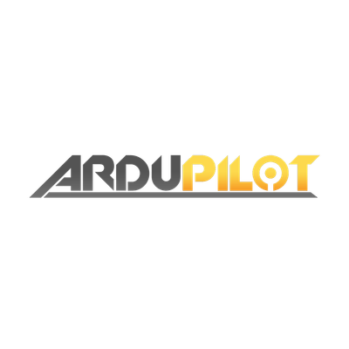

METHODOLOGY
MATLAB-ROS(Toolbox)
Position Control – Calculates position and velocity errors to generate the required force.
Desired Attitude Generation – Converts the desired force and yaw into a target rotation Rd​∈SO(3).
Geometric Attitude Control – Computes SO(3) attitude and angular-rate errors without using Euler angles.
Nonlinear Control – Generates collective thrust and body moments with gyroscopic compensation.
Control Allocation – Converts the control commands into appropriate actuator/motor commands.
Closed-Loop Feedback – The resulting motion is simulated in Gazebo, while ArduPilot continuously estimates the new state and feeds it back to the controller.
Image Data + Telementary Data
The Estimator Node (Observation Part)
The Controller Node (Control Part)
The Actuator Bridge Node
Publisher
subscriber
Publisher
subscriber
Publisher
subscriber
Gazebo Simulation
ArduPilot Software
Ardupilot in SITL

Slide 5
COMPARITIVE ANALYSIS
Proposed Work
Existed Work(Base Paper)
The ROS 2 workspace processes raw tracking states and manages 3D spatial orientations directly within unit quaternion vector spaces.
A proprietary DJI autopilot system designed to stabilize the drone.
The flight control loop operates completely manually; a person interacts with a smartphone Flask app by pressing buttons, and the Tello SDK carries out basic blind movements
The x, y, and z coordinates, along with the physical states gathered by the pipeline, are directly relayed to the drone's processing system for navigation
A highly modular, distributed middleware network with distinct, independent nodes (ROS 2 Humble) managing separate data pipelines: rtsp_camera_ingest_node, imu_bridge_node, and sync_node.
Utilized a monolithic local server to process a single video stream, decode it through an asynchronous FFmpeg thread, and render the output.
Perform Visual-Inertial Odometry by integrating the drone's IMU data into the reconstruction loop and implementing Ray-Casting Voxel Grid techniques like OctoMap or Voxblox.
Their 3D reconstruction uses monocular computer vision algorithms, combining DROID-SLAM for deep visual SLAM with CDS-MVSNet for efficient image frame processing.

Slide 6
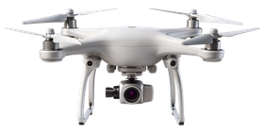






3D MAPPING OF AN ENVIRONMENT USING NORMAL MONOCULAR CAMERA AND CONTROLLING THE DRONE BY VISUAL-INERTIAL ODOMETRY (VIO)
Controll Part Parameters:
Algorithms Parts
x -
y -
z -
ψ -
θ -
Φ -
camera feed (x,y)
Manual Controll over parameters (SO3).
Visual-Inertial Odometry (VIO).
SLAM.
The Estimator Node (Observation Part)
The Controller Node (Control Part)
The Actuator Bridge Node
Publisher
subscriber
Publisher
subscriber
Publisher
subscriber

Slide 7
TERMS AND TOOLS TO BE IMPLEMENETED
SLAM
ROS 2 (HUMBLE)
MATLAB
VIO
Simultaneous Localization and Mapping provides real-time map creation and navigation solutions
The standard middleware and
software frameworks for modern robotics development
Powerful platform for algorithm development, data analysis, and numerical computation
Visual-Inertial Odometry, combining camera and IMU data for precise tracking
PID CONTROLLER
S03
DDS
POINT CLOUD
Feedback controller for precise trajectory and attitude control of robotic systems
Refers to the special orthogonal group SO(3) for modeling 3D rotations
Data Distribution Service, the underlying communication protocol for ROS 2
3D Laser Representation of 3D objects as a dense set of points, for perception
MAVLINK
ROBOSTACK
MAVROS
BODY PIERCINGS
A light-weight communicable protocol for micro air vehicles (MAVs)
Conda-based distributions for seamless ROS installation
A ROS 2 to MAVLink bridge for communicating with ArduPilot/PX4
A specific system-level constraint reference or a structural component

Slide 8
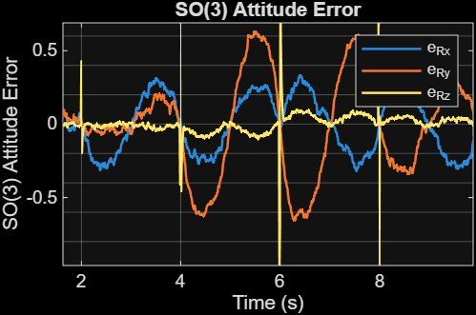
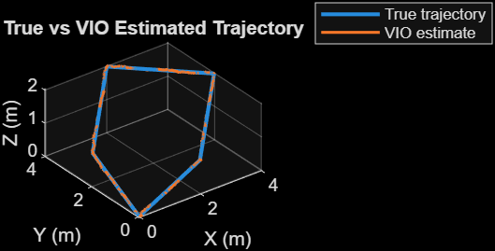
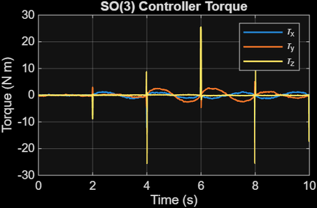
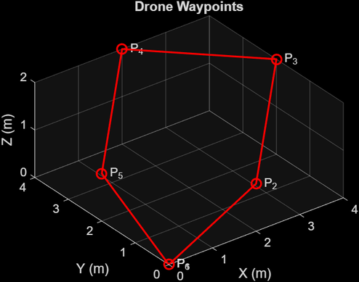
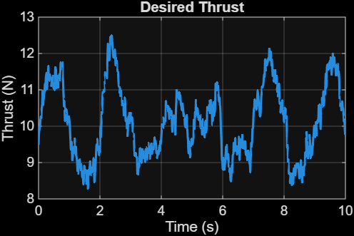
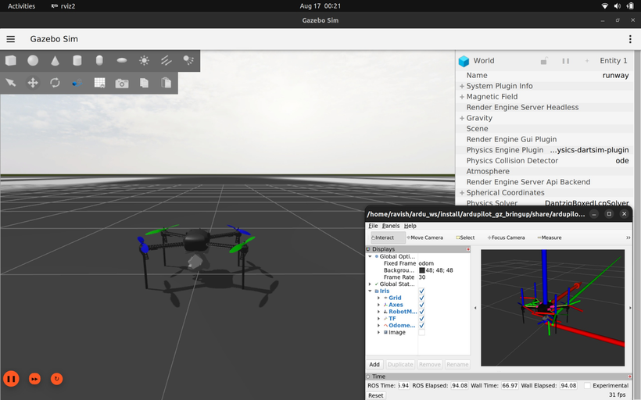
RESULTS
Shows the controller reducing attitude error while tracking the desired orientation
The VIO estimate follows the true trajectory, demonstrating effective state estimation
Shows the control torques generated by the SO(3) controller for attitude stabilization
MATLAB-generated trajectory used as the desired flight path
Gazebo simulation showing the multirotor model with ArduPilot SITL and ROS 2 visualization running in the loop
Shows the thrust command generated by the controller to maintain the required flight motion

Slide 9
REFERANCES
SLAM
BASE PAPER
GITHUB
Automatic Real-Time Creation of Three-Dimensional (3D) Representations of Objects, Buildings, or Scenarios Using Drones and Artificial Intelligence Techniques
https://www.youtube.com/watch?v=gmHnhWYfuW0&t=1s
ROS2 Phone sensors
ROBOTICS
MATLAB
GITHUB
How to communicate between ros2 humble and ros2 jazzy seamlessly?
SO3
Droid SLAM
COGNIPILOT
Release Overview

